Slide 1

Accessibility For Digital Contents & Services
Subash Acharya
03/21/2022

Slide 2
Digital Accessibility to improve User Experience
Nearly 20% (every 1 in 5) people in the world have some sort of permanent or temporary disability.
71% of disabled users don’t use website or application simply because digital content is not accessible.
Last year, more then 2000 websites accessibility lawsuits were filed by plaintiffs because they were not ADA (American Disability Act) complaint.
Section 508 of the Rehabilitation Act of 1973 (29 U.S.C § 794 d) & American with disability act of 1990 (ADA)

Slide 3
Impacted | Common Problems with Digital Contents
Color Blind | Only color is used as a unique marker to emphasize text on a Web site. Text that inadequately contrasts with background color or patterns.
Deaf | Lack of captions or transcripts of audio on the Web, including webcasts. Lack of content-related images in pages full of text.
Low Vision | Web pages with absolute font sizes that do not change. Difficult to navigate when enlarged, due to loss of surrounding context. Web pages, or images on Web pages, that have poor contrast. Text presented as images, which prevents wrapping to the next.
Motor Disabilities | Time-limited response options on Web pages. Tools that do not support keyboard alternatives for mouse. Browsers and authoring tools that lack keyboard support for all commands.
Blind | Images that do not have alternative text Complex images (e.g., graphs or charts) that are not adequately described. tables that do not make sense when read serially (in a cell-by-cell or "linearized" mode) Frames that do not have "NOFRAME" alternatives, or that do not have meaningful names Forms that cannot be tabbed through in a logical sequence or that are poorly labelled.
Seizure | Use of visual or audio frequencies that might trigger seizure.

Slide 4
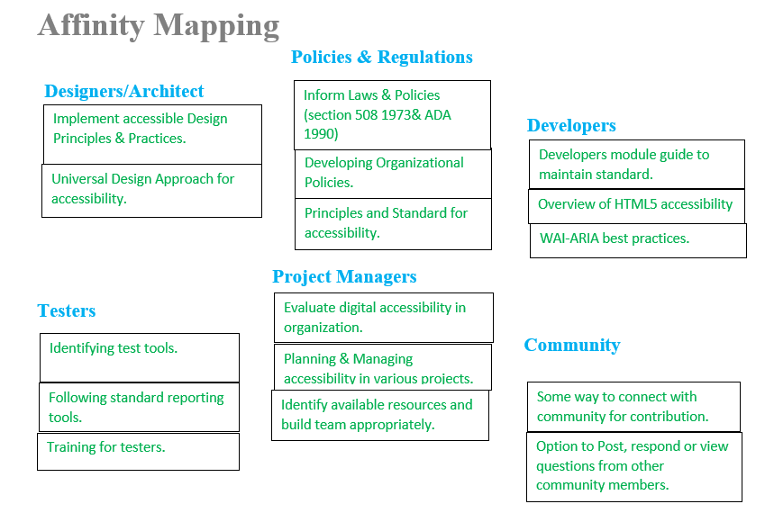

Slide 5
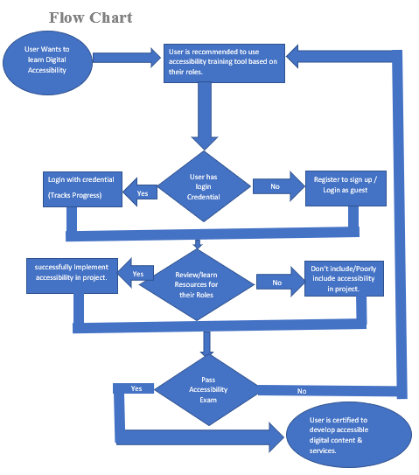

Slide 6
Persona:
User is a team member of project to develop digital consent. User is trying to improve knowledge about digital accessibility to implement new skills to make product more accessible. User is looking for one stop solution which provides various resources based on team roles.
Problems Statement:
We share digital information or provide digital services to reach out to as many users as possible. Unfortunately, certain people with disabilities cannot get that information or services we want to provide. This is against our mission &/or vision. Information or services should be accessible to all irrespective to their physical or medical condition. Developing skills to address digital accessibility issues is the law. Our tool will provide those resources to various team members in our team.

Slide 7
Story Arc
Introduction: Digital accessibility is important to share information &/or services for all including disable users to reach out to more users.
Incident: Disable individuals have issue with getting information they need because of lack of accessibility.
Raising Action: There are some instances of lawsuit action because of accessibility issue.
Climax: There are laws to make digital content & services accessible. Team members must get training based on their role to create accessible project.
Resolution: We need to provide training for our team members to address accessibility at early phase of project. If possible, all disable groups should be addressed.
Conclusion: We must consider accessibility while developing digital content or services, this is the law.

Slide 8
Service Experience
Improve experience of disabled individuals while accessing digital information or services.
Improve experience of team members who are developing, enhancing or maintaining digital information and services.

Slide 9
Wireframe & Prototype
Please check Wireframe & Prototype in Figma
For detail Document Please check AccessibilityForDigitalContent&Services
ANY QUESTIONS ?

